Slide 1


Driver Drowsiness Detection
KADI SARVA VISHWAVIDYALAYA
LDRP INSTITUTE OF TECHNOLOGY AND RESEARCH
PROJECT-I(CT606-N)
GROUP NO. G62
Guided By:
Prof. NIMESH PATEL
Prepared By:
ACHARYA YAGNANG (21BECE30003)
BAROT PARTH (21BECE30014)

Slide 2
Definition
Driver Drowsiness Detection is the Process of Identifying when a driver is becoming drowsy while driving a vehicle which is done through the use of Cameras and machine learning algorithms to detect signs of drowsiness such as yawning, drooping eyelids and changes in facial expressions. The goal of this technology is to prevent accidents caused by drowsy driving.

Slide 3
Why Driver becomes Drowsy…?
Why Drowsiness is Dangerous…?
Continuous driving can be tedious and exhausting. CDC defines drowsy driving as a dangerous combination of driving and sleepiness. Due to the lack of allowed body movement, a driver might start to have droopy eyes,feel sleepy and eventually fall asleep while driving.
It impairs the driver's ability to focus, react, make decisions, and stay alert, putting themselves and others on the road at risk of a crash. Drowsiness reduces the brain's ability to process information and make judgments, leading to delayed reactions, increased lane drifting, and decreased overall awareness. Drowsy driving also increases the risk of falling asleep at the wheel.

Slide 4
Signs of Drowsy Driver
Having trouble focusing and/or keeping your eyes open.
The inability to keep your head up.
Daydreaming or experiencing wandering, disconnected thoughts.
Tailgating, drifting out of your lane, or swerving off the road.
Yawning frequently or rubbing your eyes repeatedly.

Slide 5
Statistical Data

Slide 6
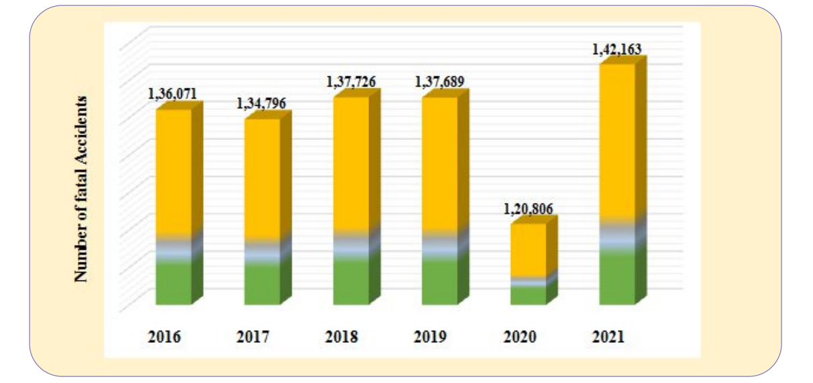
Trends in the number of Fatal Accidents: 2016-2021

Slide 7
Actions taken by Government to reduce road accidents
Proactive approach towards road safety by Ministry and all stakeholders contributed to reduce road causality over the years. Besides this, the implementation of the Motor Vehicle Amendment Act 2019, which became effective from 1 September, 2019 contributed to reduce road accidents. The MVA Act 2019 included, inter-alia, provisions like stiff hike in penalties for traffic violations, electronic monitoring of the same, enhanced penalties for juvenile driving etc. and the implementation of the same has enabled achieving the desired impact.

Slide 8
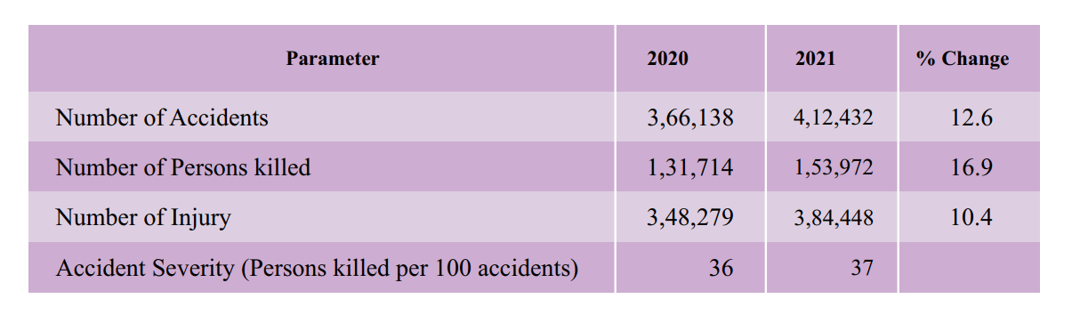
PROFILE OF ROAD ACCIDENTS
During 2021, a total of 4,12,432 accidents were reported by all States/UTs, of which, 1,42,163 (34.5 %) were fatal accidents. The number of persons killed in road accidents were 1,53,972 and caused injury to 3,84,448 persons. Total number of Road accidents in 2021 compared to the previous year 2020, increased on average by 12.6 percent, the number of persons killed increased by 16.9 percent and the number of persons injured increased by 10.4 percent.

Slide 9
Driver Statistics

Slide 10
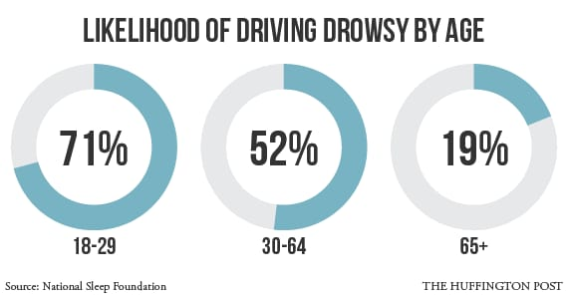
Driver Statistics

Slide 11
Driver Statistics
Young Drivers: ages 18-29 have the highest likelihood to drive while drowsy (71 percent) compared to other age group, according to the National Sleep Foundation (NSF).
Commercial Drivers: are at a significantly higher risk for crashes caused by drowsiness. The reasons for this include the long hours on the road and high number of miles they need to drive as part of their jobs. Additionally, many of these drivers tend to be more at risk for a variety of sleep disorders.
Shift Workers: who work night shifts, double shifts or swing shifts are also six times more likely to be involved in a drowsy driving crash according to a study conducted by AAA Foundation for Traffic Safety.
Business Travelers: are also at a higher risk for a drowsy driving crash, as they travel across time zones, suffer from jet lag, too little sleep, and spend many hours driving to get to their destination.

Slide 12
Technology Used

Slide 13
OpenCV (Open Source Computer Vision Library): For processing video streams, including capturing frames from the webcam, image resizing, and color conversion.
Dlib: A toolkit for machine learning and computer vision tasks, utilized here for face detection and facial landmark localization.
Streamlit: A Python library for building interactive web applications, used for creating the user interface to adjust parameters and visualize the drowsiness detection process.
Pygame: A cross-platform set of Python modules designed for writing video games, employed here for playing alert music when drowsiness is detected.

Slide 14
Literature Review

Slide 15
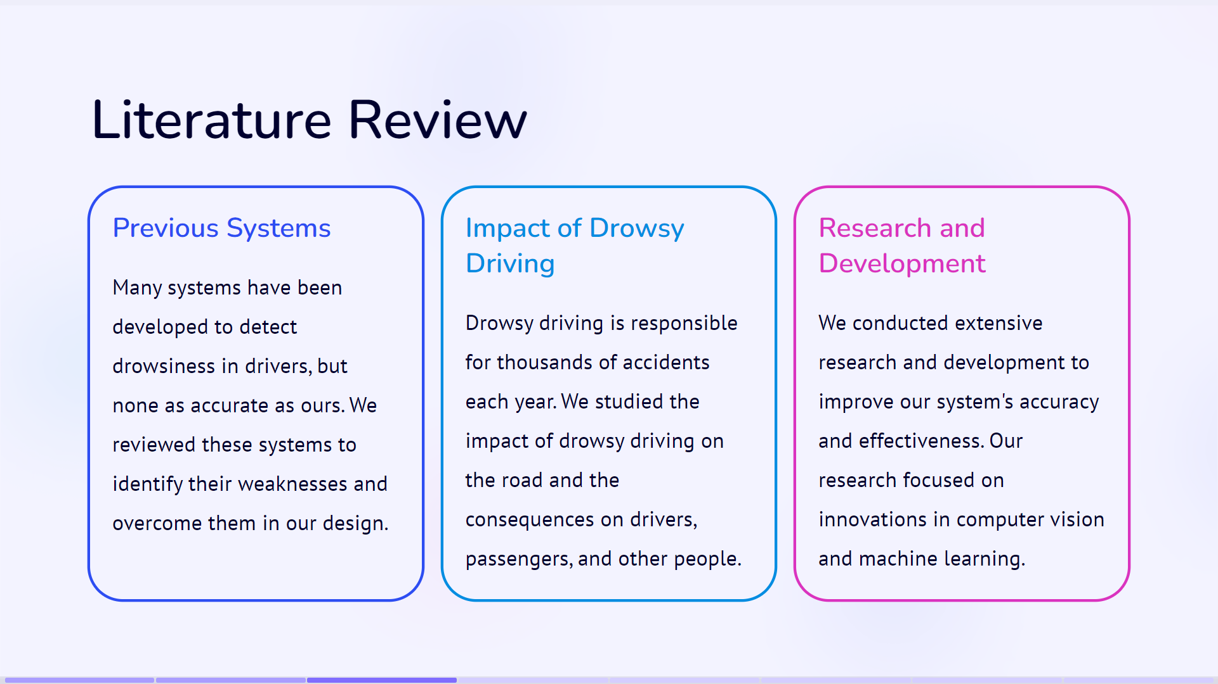

Slide 16
System Design

Slide 17
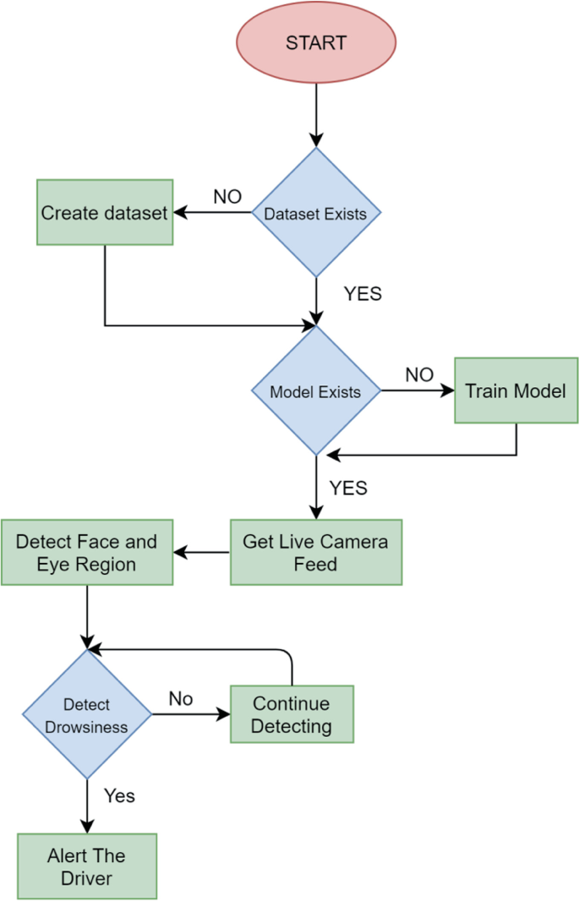
BASIC BLOCK DIAGRAM

Slide 18
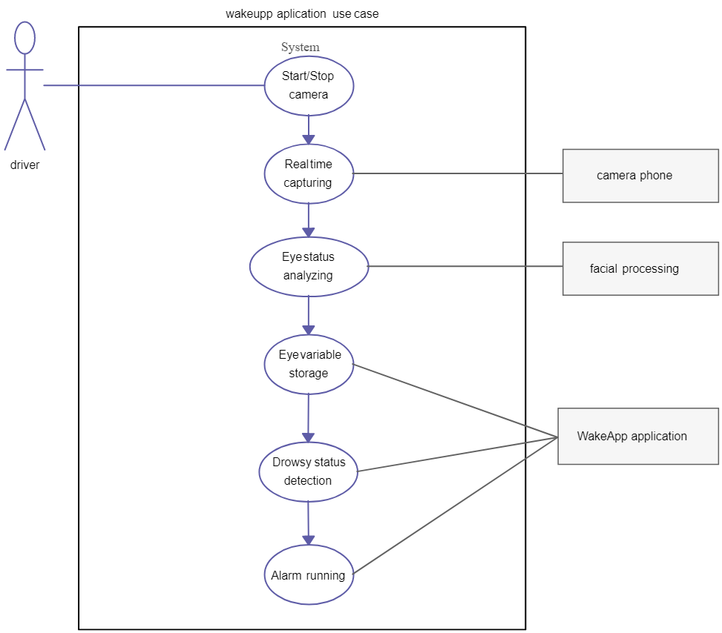
Use Case Diagram

Slide 19
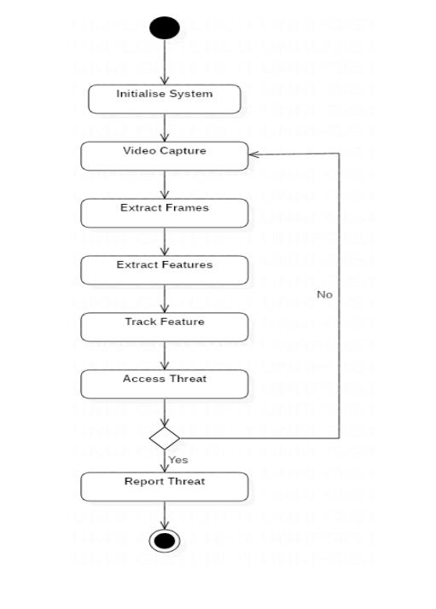
Activity Diagram

Slide 20
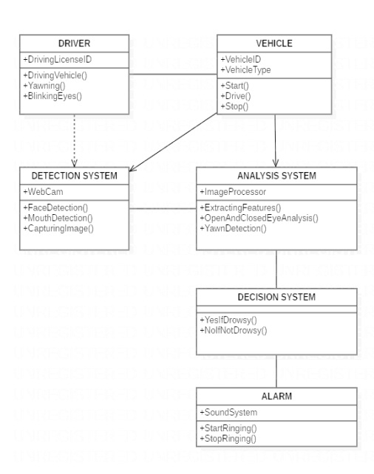
Class Diagram

Slide 21
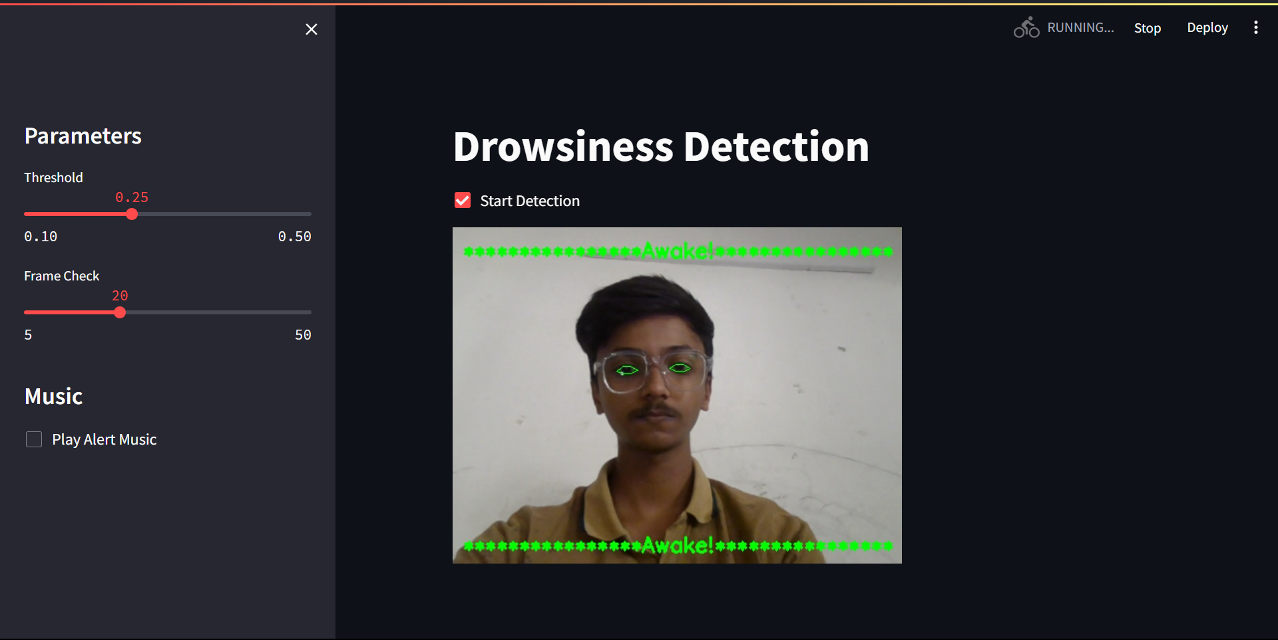
Results
Detection in awake state

Slide 22
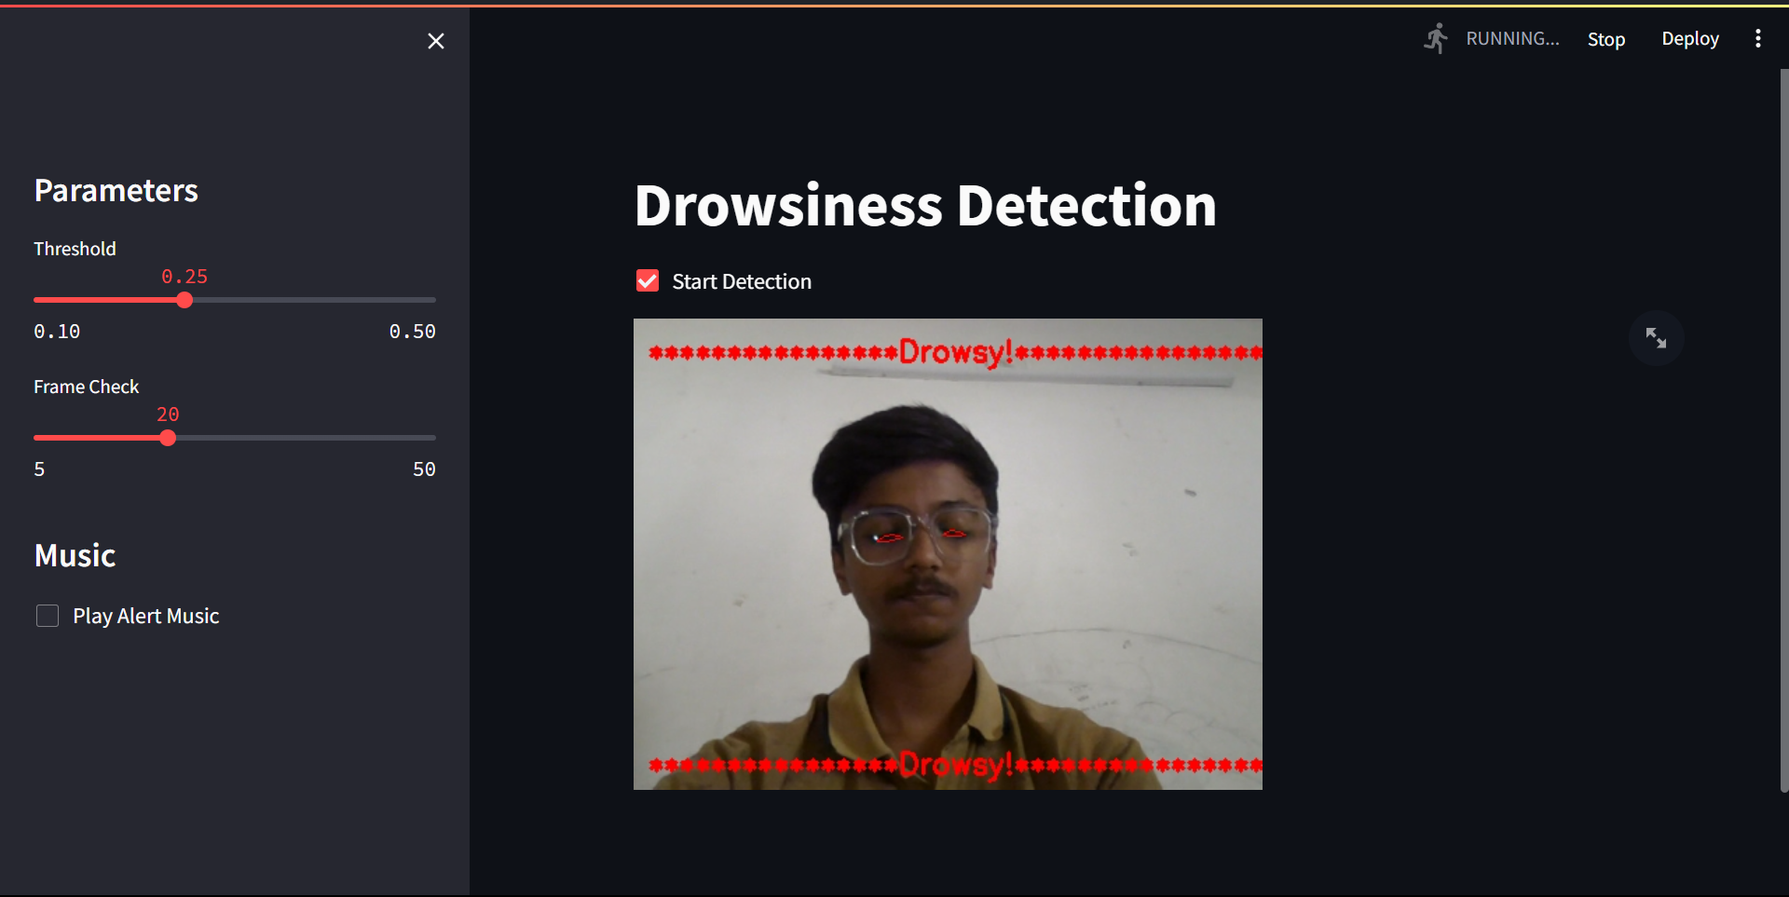
Results
Detection in drowsy state

Slide 23
Applications of the system
Automotive industry
Long-distance trucking
Public transportation
Fleet management
Military and law enforcement.
Mining and construction.

Slide 24
Advantages of the system
Increased safety
Cost-effective
Improved productivity
Early detection
Customizable
Better driver performance
Fit for different environments

Slide 25
Drawbacks of the system
False alarms
Limited accuracy
Privacy concerns
Limited field of view
Limited applicability
Limited to driver

Slide 26
Future Scope

Slide 27
The future scope for driver drowsiness detection is promising as it can greatly improve road safety. Here are a few potential future developments in this field:
Integration with vehicle systems
Advanced sensors
Personalized drowsiness detection
Integration with smart devices
Overall, with the integration of advanced technology and the use of machine learning and AI, drowsiness detection systems have the potential to significantly improve road safety.

Slide 28
Conclusion
Driver drowsiness detection system use a variety of methods to detect when a driver is becoming fatigued, including monitoring eye movement, head position, and facial expression.
Our system can be effective in reducing the risk of accidents caused by drowsy driving. However, these systems are not foolproof, and it is still important for drivers to be aware of their own level of fatigue and to pull over and rest when necessary.
Overall is a major step forward in ensuring road safety. Our use of Python, YOLOv5, and OpenCV allows for high-precision detection and immediate response. Despite a few minor drawbacks, our system is easy to install and operate, and provides a major improvement in road safety.

Slide 29
References
https://pytorch.org/docs/stable/index.html
https://docs.ultralytics.com/
https://docs.opencv.org/4.x/
https://en.wikipedia.org/wiki/Transfer_learning
https://docs.python.org/3/
https://github.com/nicknochnack/YOLO-Drowsiness-Detection
https://github.com/heartexlabs/labelImg

Slide 30
THANK YOU

